Slide 1
Global Bike Fiori Launchpad
Curriculum: Introduction to Fiori Launchpad

Slide 2

4.3 (August 2025)
S/4HANA 2023
Fiori 3.0
Global Bike
No Prerequisites needed

Slide 3
Yeganeh Rashed
Beginner

Slide 4
You are able to
to build up an understanding of SAP Fiori Launchpad

Slide 5
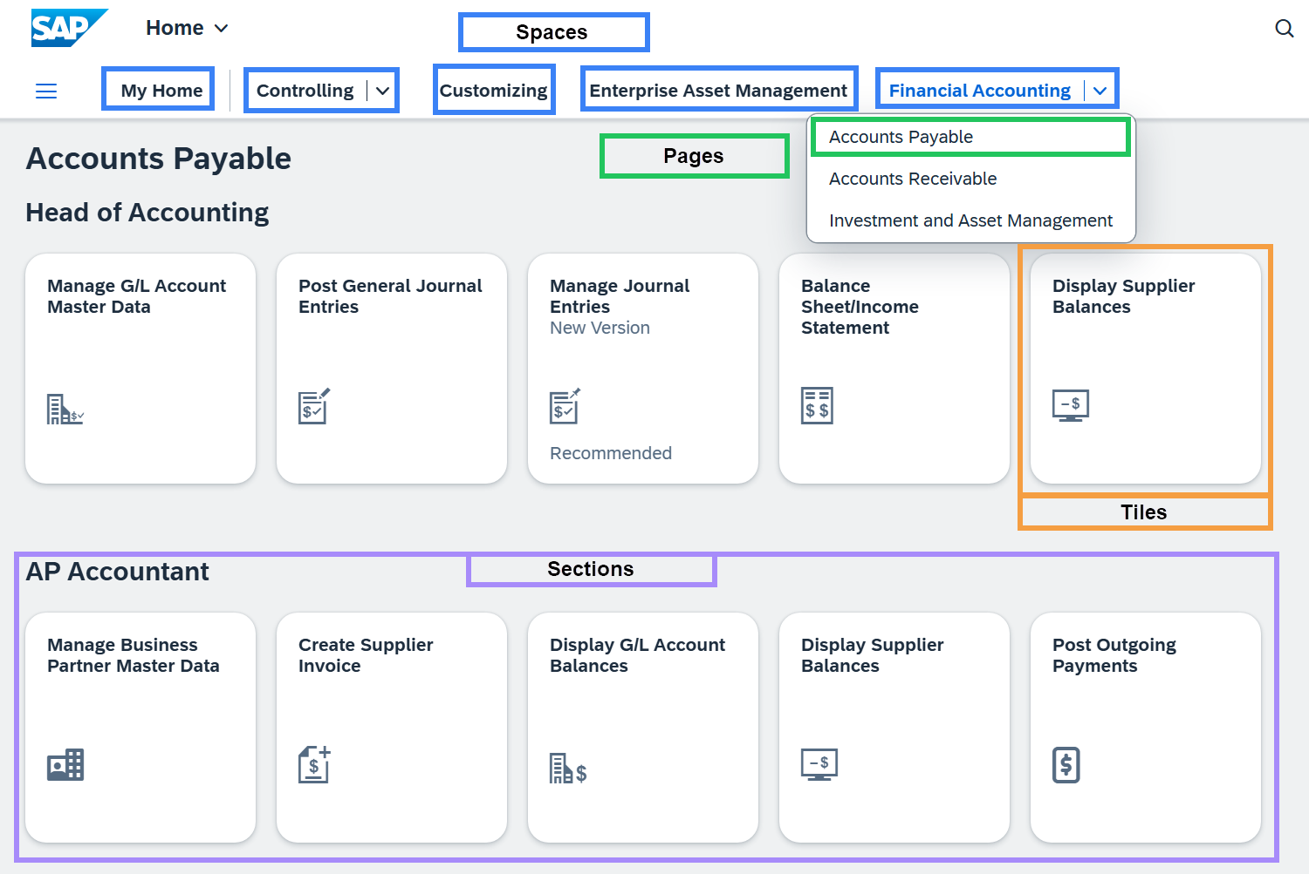
Fiori Launchpad: An Overview
SAP Fiori Launchpad:
  The modern user interface
  A standardized, role-based entry point for applications
  It is based on tiles that represent apps
  It is designed for an intuituve, user friendly experience (UX)
  The standard user interface in new SAP systems, like SAP S/4HANA

Slide 6
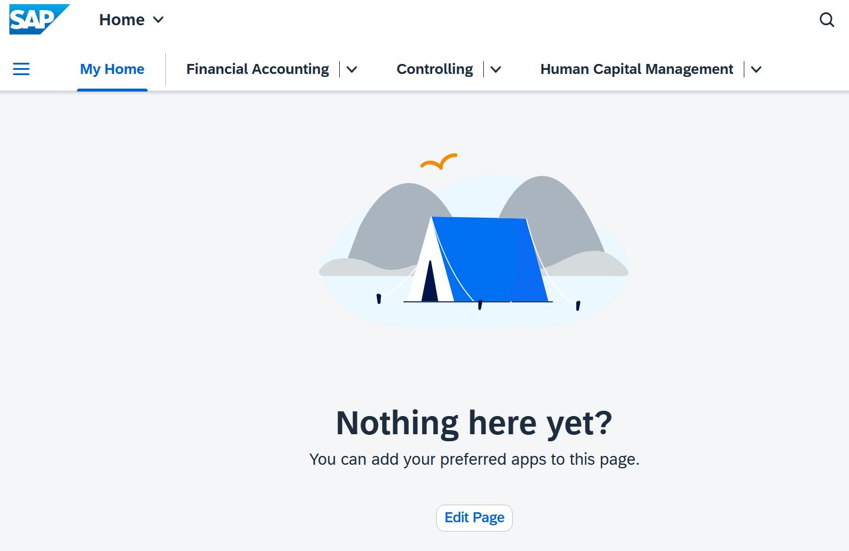
Fiori Launchpad: An overview
The Fiori Launchpad includes a section called
„My Home“.
This page is usaually empty when you log in for the first time.
Users can customize it to suit their needs.
Frequently used tiles or applications can be added.
This creates a personalized work interface tailored to your tasks.

Slide 7
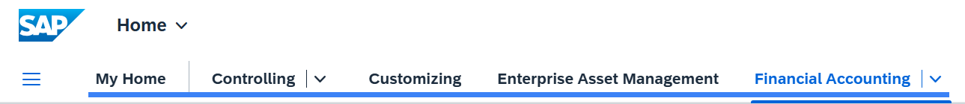
Structure of the SAP Fiori Launchpad
Space
  Represents the highest organizational level within the user interface structure
  Consolidates thematically related applications for a specific user role or business area
  Each space is designed for a defined work context

Slide 8
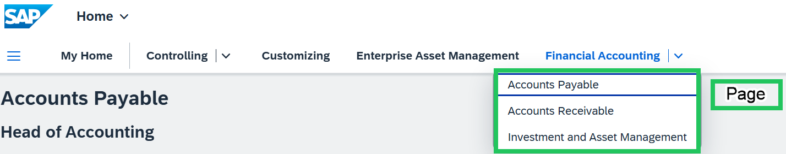
Structure of the SAP Fiori Launchpad
Page
  Each space comprises at least one page
  Serves as the primary workspace where applications and information are presented
  Facilitates the structured presentation of a space’s content

Slide 9
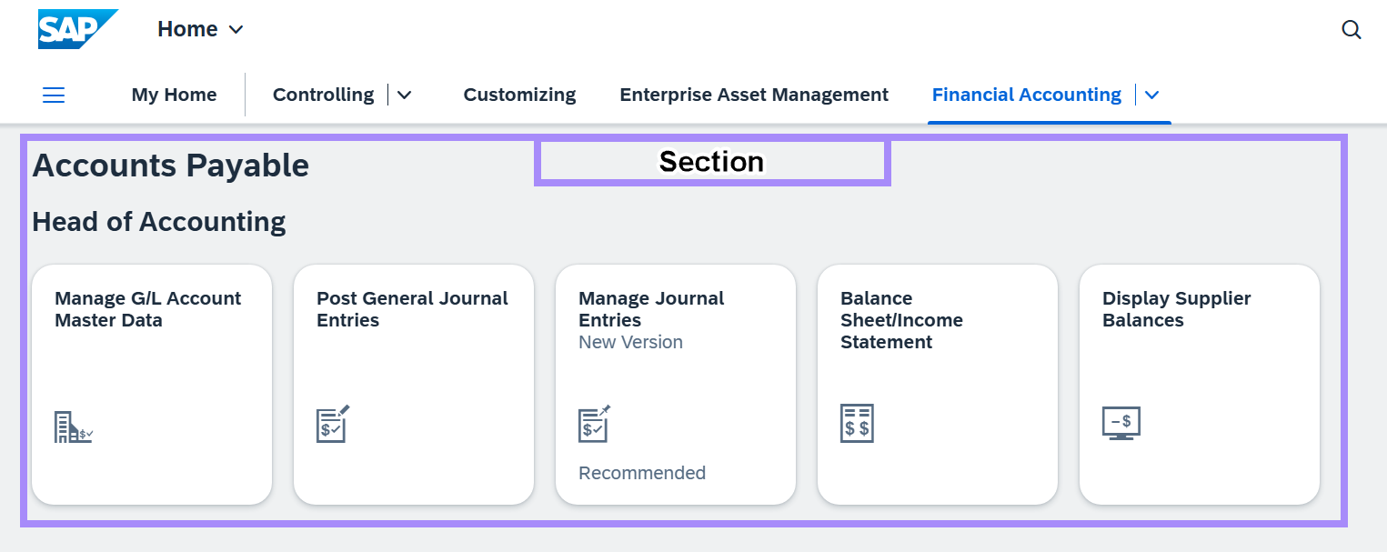
Structure of the SAP Fiori Launchpad
Section
  Serves to further subdivide pages
  Groups tiles according to specific tasks or processes
  Enables improved clarity and organization

Slide 10
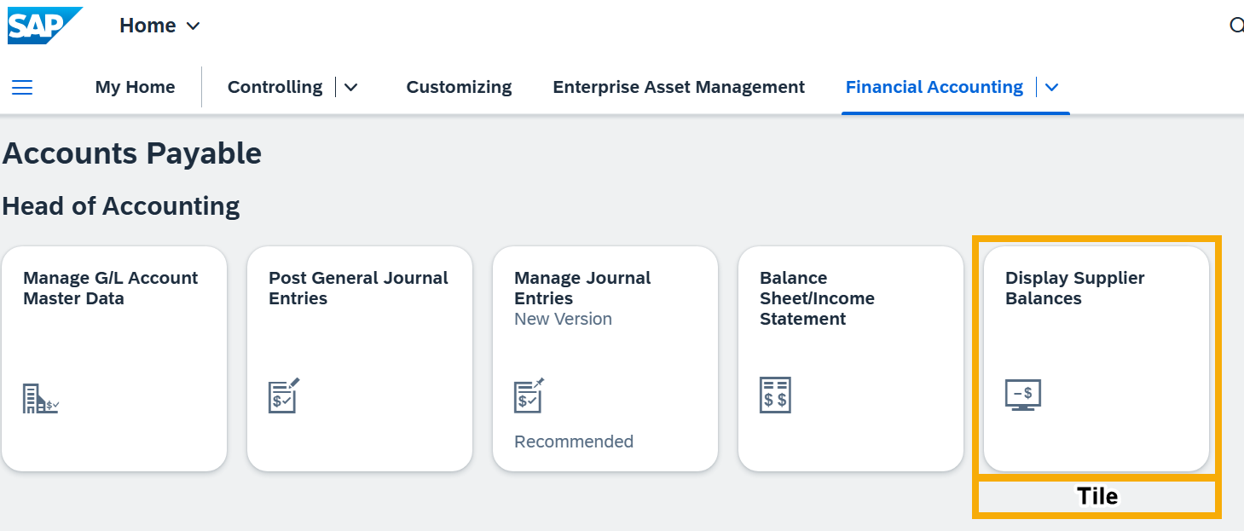
Structure of the SAP Fiori Launchpad
Tiles
  The smallest interactive elements on a page
  Provide direct entry points to applications

Slide 11
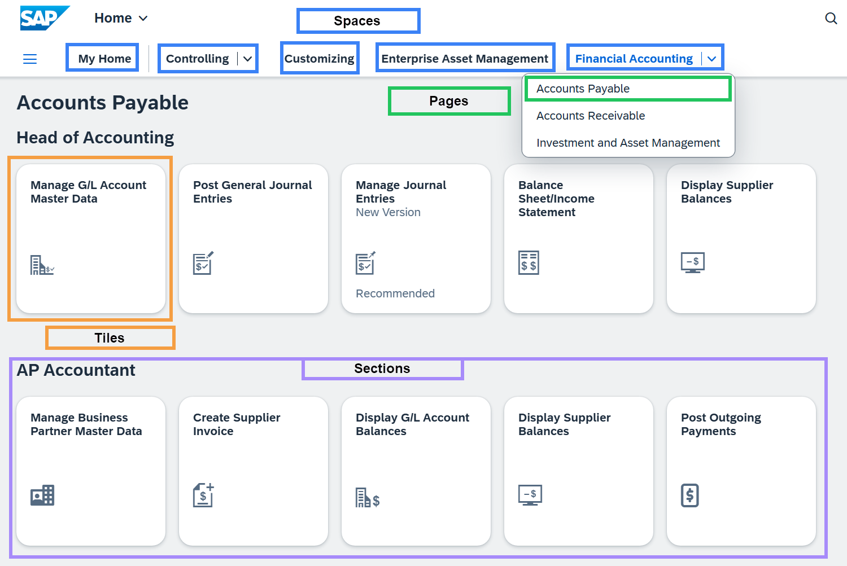
Navigation Flow Summary
Space: Selects the overarching area of responsibility
Page: Directs the user to the main workspace
Section: Groups tiles according to specific tasks
Tile: Launches the desired application
Spaces (e.g. Financial Accounting)
↳ Pages (e.g Accounts Payable)
↳ Sections (e.g. AP Accountant)
↳Tiles (e.g. Display Supplier Balances)

Slide 12
Roles (Business Roles)
Roles (Business Roles)
  form the foundation of the authorization structure.
  define which content a user is allowed to see and use.
  Without an assigned role, the user cannot see any areas, pages or tiles.

Slide 13
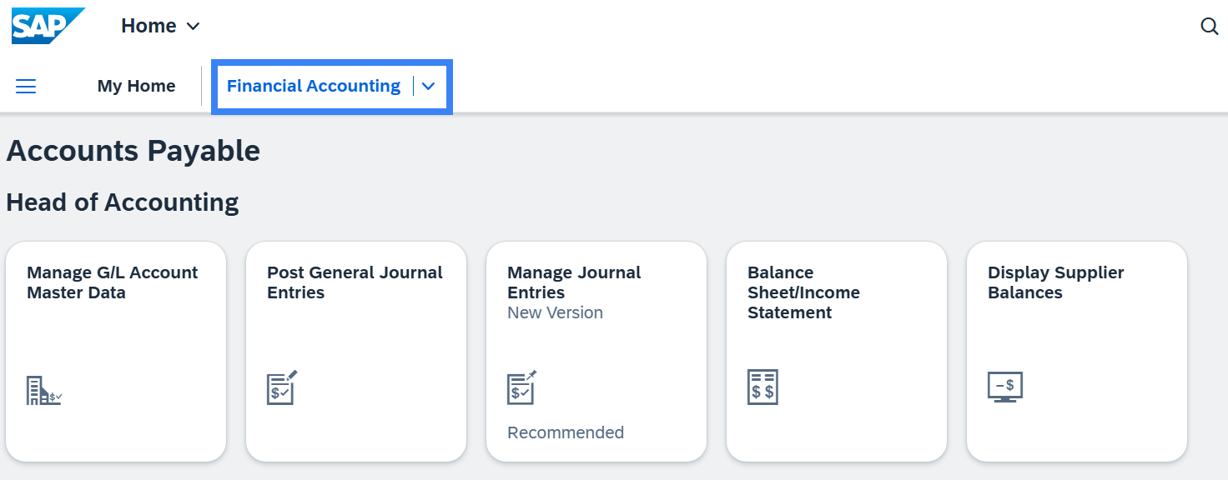
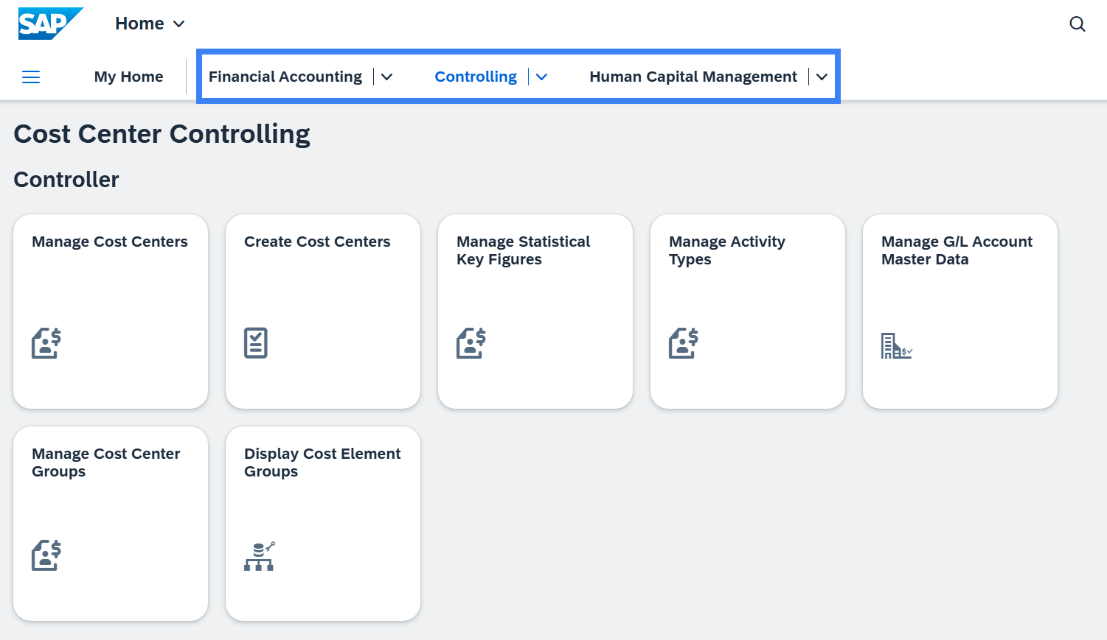
Roles (Business Roles)
  With one role:
  With several roles:

